Slide 1

CreateWordPress Website
By
Karthik

Slide 2
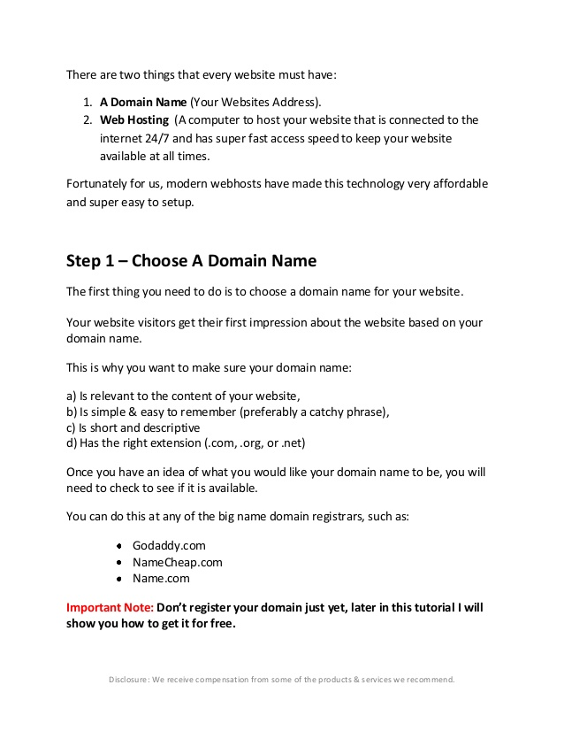
Steps to create website

Slide 3
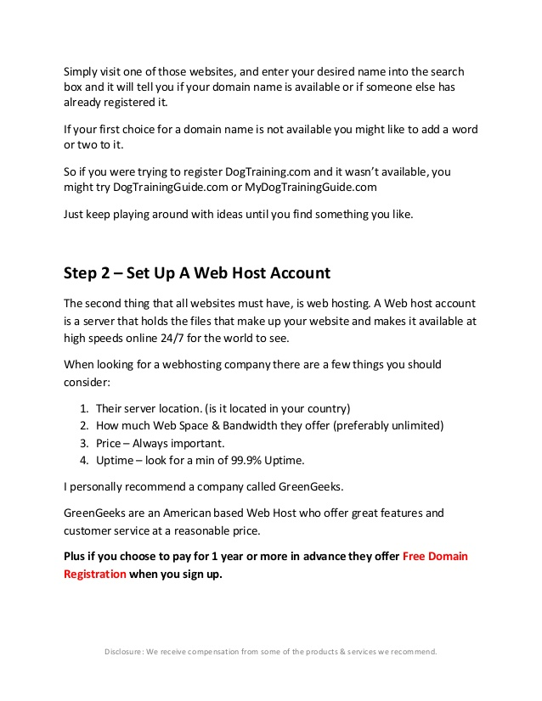
Steps to create website cont’d

Slide 4
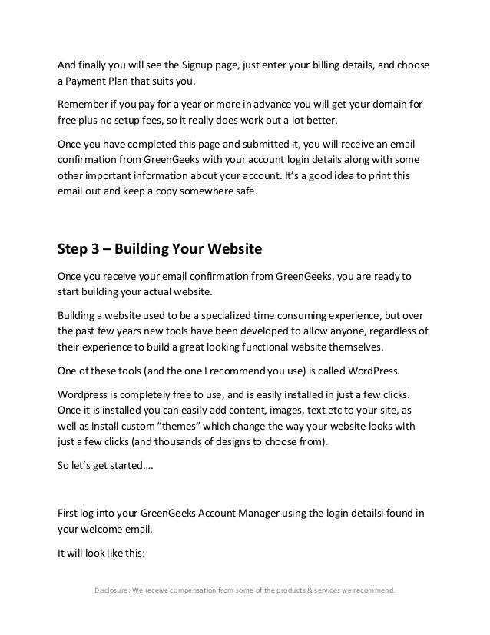
Steps to create website cont’d

Slide 5
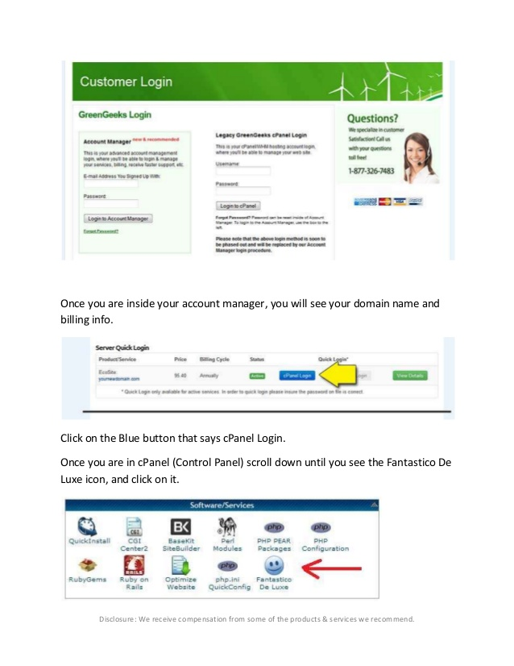
GreenGeeks login

Slide 6
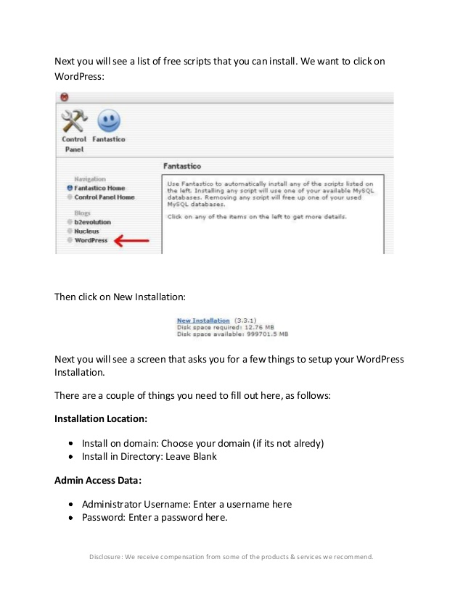
Installation

Slide 7
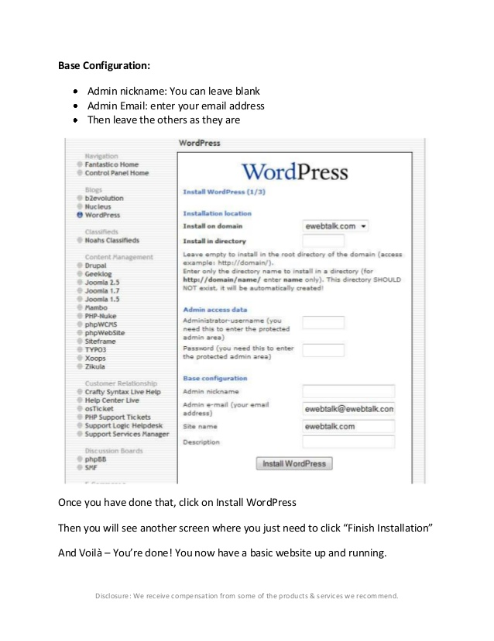
Create WordPress website

Slide 8
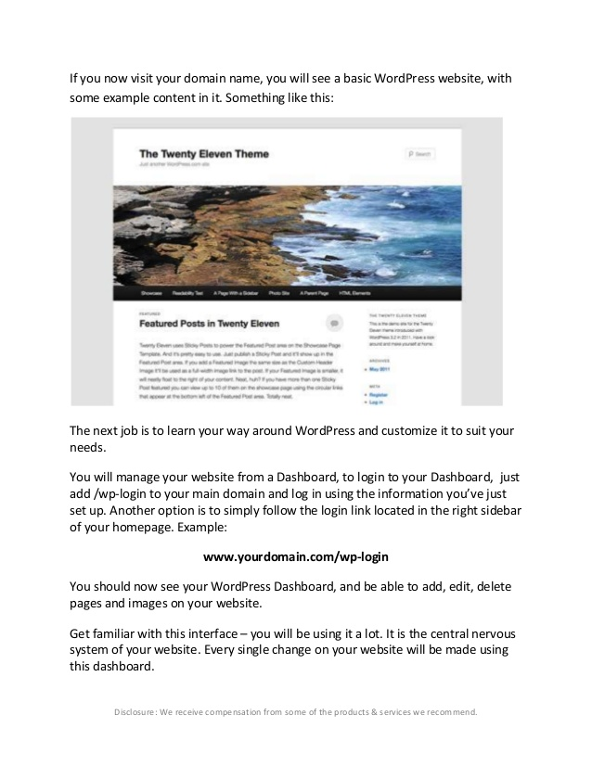
Word press website

Slide 9
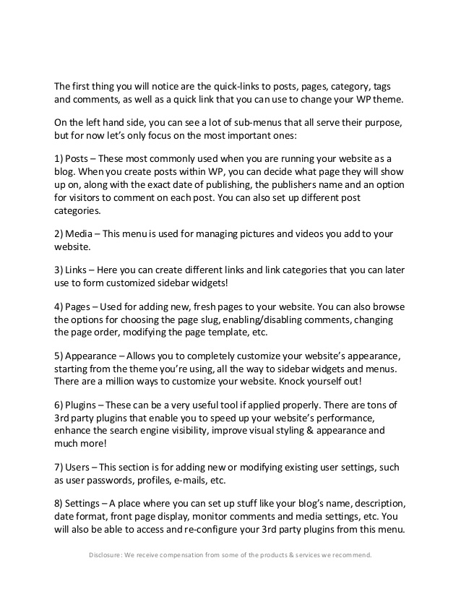
Important bulletins

